Slide 1



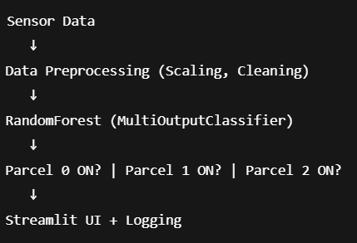
Name of Project :Smart_irrigation using machine learning
Aicte:STU680f1ff9dd6b21745821689 Name:Mohd Farrakh Nizam
• July 2025 • CEC jhanjeri,mohali

Slide 2

Learning Objectives
Understand multi-label classification
Apply machine learning to agriculture
Simulate real-time predictions
Develop a Streamlit web interface
Build logging and reporting functionalities
Goal: Build a system that can automatically decide which irrigation parcels need watering, using data and machine learning.
GOAL

Slide 3
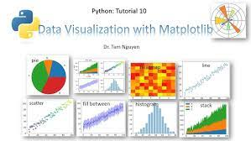
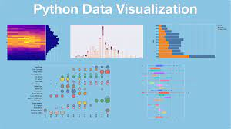
Features and Upgrades:
Core Features:
Multi-label model: Predicts multiple outputs (e.g., Parcel 0 = ON, Parcel 1 = OFF, etc.)
Feature scaling: Ensures model performs well with normalized inputs
Upgrades:
Real-time simulation: Simulates incoming sensor data with random values
Streamlit UI: Lets users input values and see predictions visually using ngrok interface.
Logging system: Records predictions along with timestamp for tracking decisions
IoT-ready: The system could easily plug into real sensors in the future

Slide 4
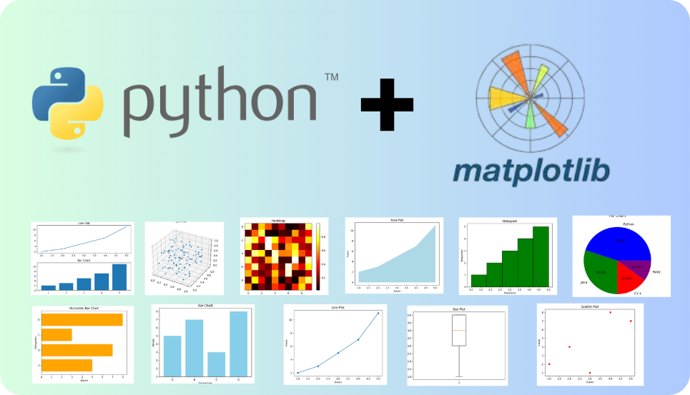
Tools and Technology used :
Category | Tools Used
Programming | Python
ML Libraries | Scikit-learn
Data Handling | Pandas, NumPy
Visualization | Matplotlib, Seaborn
Interface | Streamlit
Modeling | RandomForest + MultiOutputClassifier
Logging | Python's datetime + file I/O
Development | Google colab

Slide 5
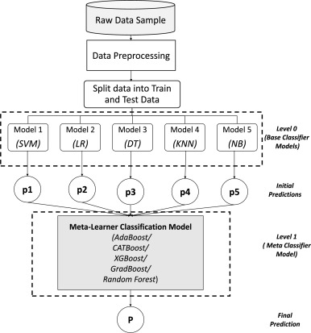
Methodology :
Data Cleaning: Dropped unnecessary columns like Unnamed: 0
Feature/Label Split: First 20 columns were features (X), the rest were labels (y)
Scaling: Applied MinMaxScaler to normalize the data
Model Training:
Used RandomForestClassifier for robust decision trees
Wrapped in MultiOutputClassifier to handle multiple labels at once
Prediction & Evaluation:
Used classification_report to assess performance
Simulation: Added random input simulation to test predictions
Logging: Saved prediction results with timestamp in a .txt file
Deployment Interface: Created a Streamlit web UI to interact with the model

Slide 6
Problem Statement:
Traditional irrigation systems often:
Waste water by over-irrigating
Lack precision in activating zones
Need manual labor and supervision
Goal: Build a system that can automatically decide which irrigation parcels need watering, using data and machine learning.

Slide 7
Solution:
A trained model predicts which parcels need to be activated.
Simulates real-time use by generating synthetic sensor inputs.
Users can access a web dashboard to test the system.
Each decision is logged for auditing and future analysis.
Ready for future integration with IoT devices or weather APIs.

Slide 8
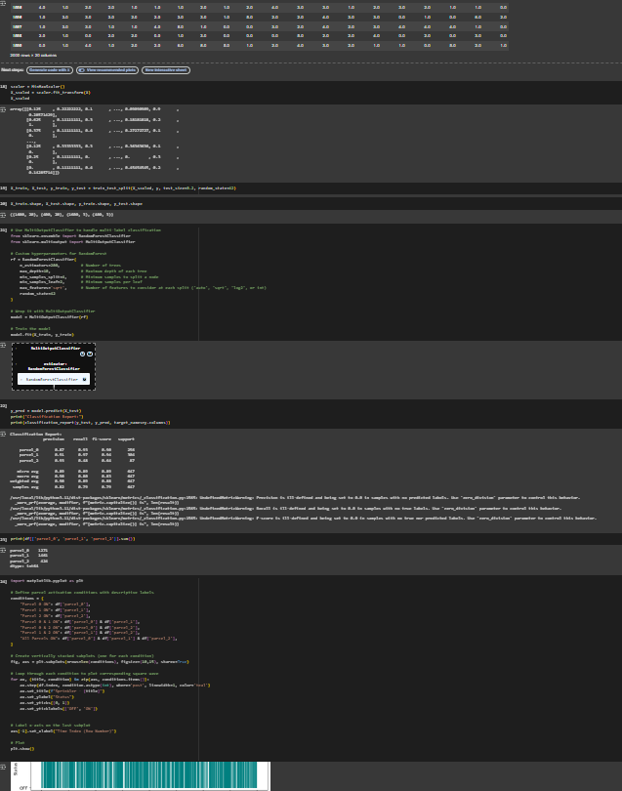
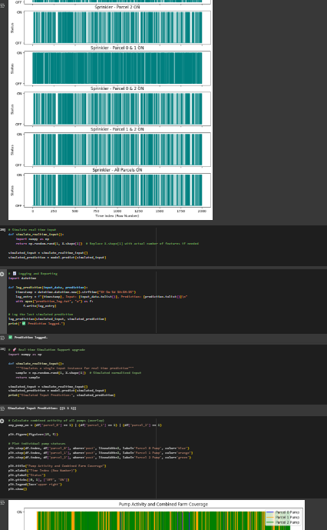
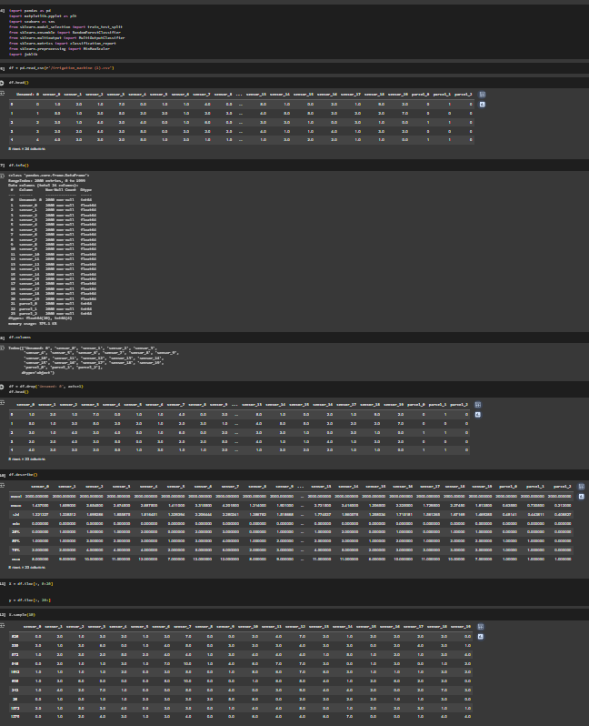
Screenshot of Output:

Slide 9
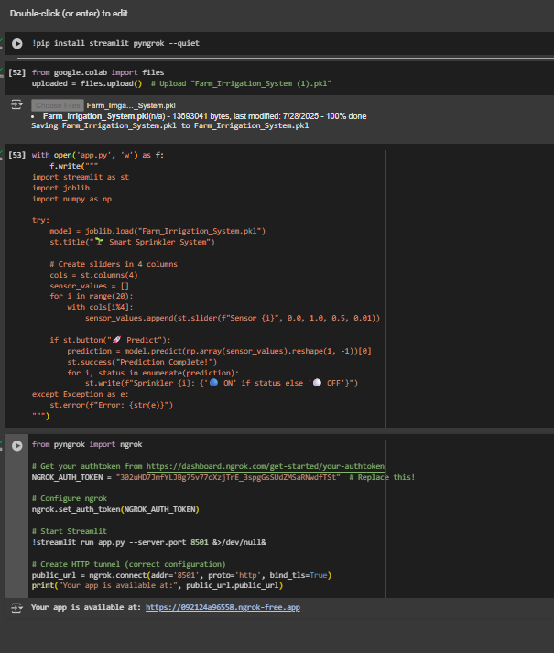
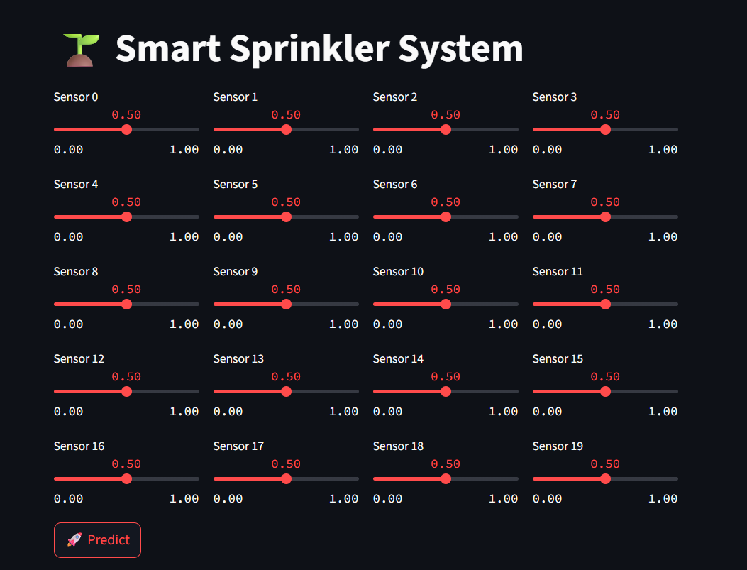
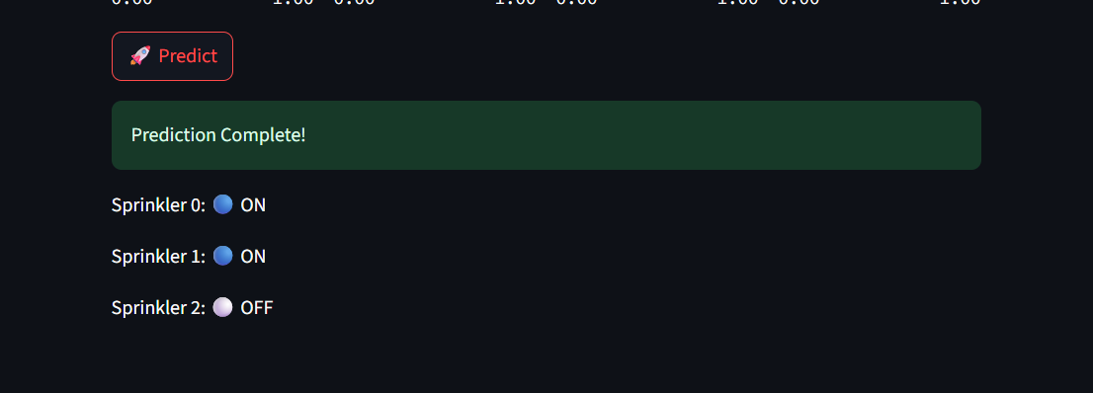
Screenshot of Output:

Slide 10
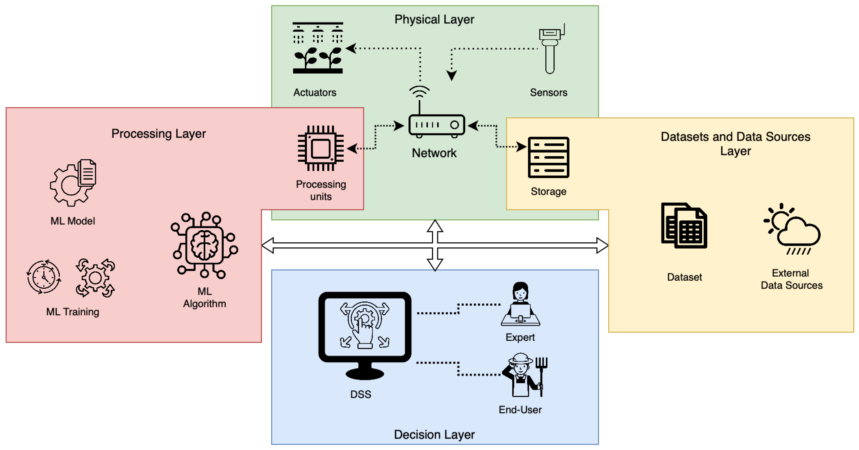
Conclusion:
You successfully built a data-driven smart irrigation system using:
ML for intelligent decisions
Streamlit for real-time input and prediction visualization
Logging for tracking decisions
This system is a strong prototype for precision agriculture, smart farms, or even water-saving initiatives.

